Slide 1
Field Display Annotations …using metadata & partial classes
David Turton
Conestoga College
Institute of Technology and Advanced Learning
dturton@conestogac.on.ca
Doon 2A605 x3610

Slide 2
Objectives
Create a metadata class for each model
→ to avoid contaminating the generated model
Apply metadata to a partial class
An overlay for the model with the same name & namespace
… will annotate the model without touching it
Use Annotations to modify Razor defaults:
Show a user-friendly name for a field,
Show/don't show, or hide a field
Format fields: currency, dates, numerics
Make a field read-only
Influence the type of control & DataType checks

Slide 3
We Need to Annotate the Model for display, validation & translation
Annotations like [Required], [Display] and [DataType]
Are applied to properties in the model
Will enforce basic validation rules
…or control how the property is displayed
However
The models were generated by Entity Framework
…we will lose the annotations if the models are regenerated
Like: changing a manual key into an identity column
We need to keep the annotations separate
But still linked to the model
Solution: Metadata Classes & Partial Classes

Slide 4
Metadata classes
These have property definitions
Just like the generated models
However, these are used to identify the fields
Fields that each annotation is being applied to
Not to actually define/redefine the fields
Because EF generates models as partial classes
Another partial class with the same name & namespace
With properties, methods & characteristics
Will have these added to other partial views of same name
Conflicting or duplicated properties & methods will cause a build error.

Slide 5
Partial-Class Namespaces
It isn't enough for two partial classes to be named the same
They need to be in the same namespace
They can't be in the same physical folder
So you modify their logical location:
namespace MusicStore.Models
{
[ModelMetadataType(typeof(AlbumMetadata))]
public partial class Album
{
}
.MetadataClasses
.MetadataClasses

Slide 6
Creating Metadata Classes Create sub-folder ~/Models/MetadataClasses (or whatever)
For each model class:
Create a class file named after the model, suffixed with Metadata
public class AlbumMetadata // this is the metadata class for the "Album" model
Copy the model's physical properties to this class
Add a second class to this file, named after the model
Declare it to be a partial class
public partial class Album // this partial class will merge with the "Album" model
Remove the subfolder ".MetadataClasses" from the file's namespace
namespace MvcMusicStoreCore.Models.MetadataClasses
So it's logically in same namespace as the original model
Apply the Metadata class to the partial-class copy
[ModelMetadataTypeAttribute(typeof(AlbumMetadata))]
public partial class Album // this partial class will merge with the "Album" model

Slide 7
[ModelMetadataTypeAttribute(typeof(AlbumMetadata))] - the "Attribute" extension is optional, by the way
In the .NET Framework
This used to be the MetadataTypeAttribute
In the System.ComponentModel.DataAnnotations namespace
In the .NET Core
This is located in Microsoft.AspNetCore.MVC namespace
Different name, different namespace
Not hard to locate at all …

Slide 8
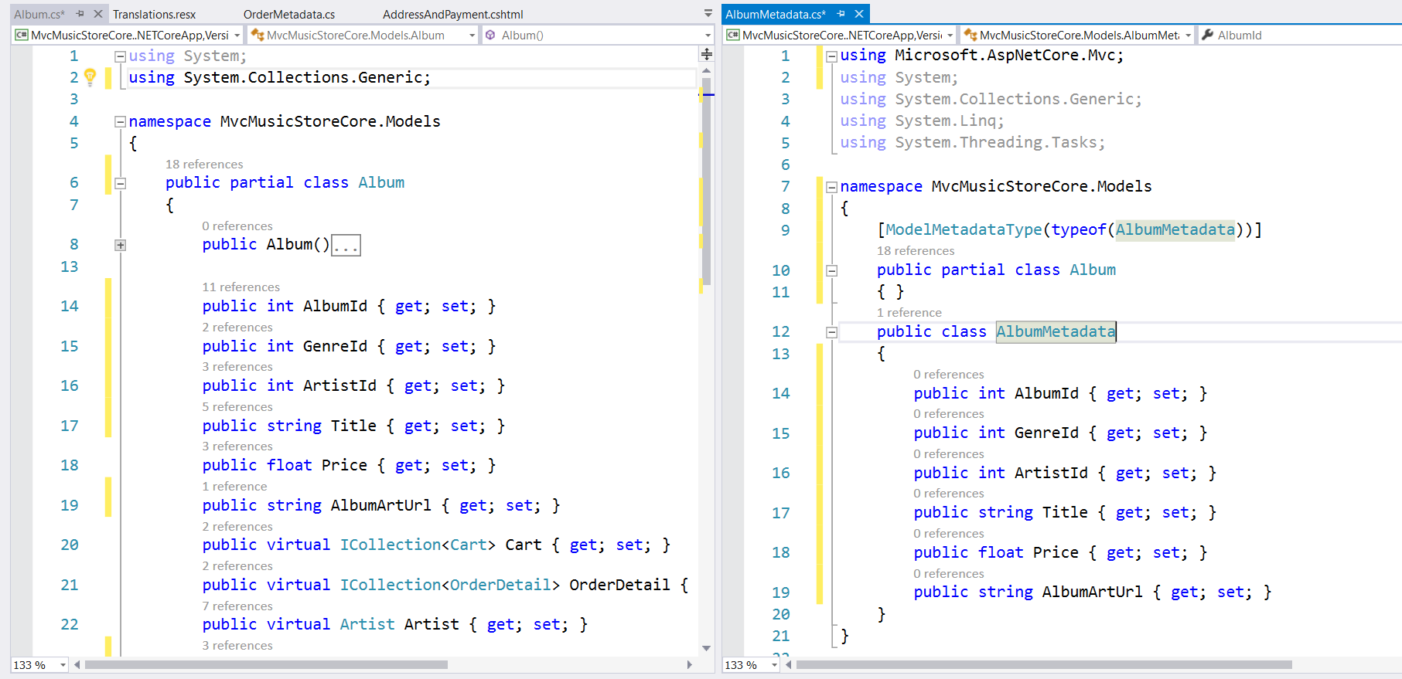
Create & apply metadata class pre-load with concrete properties
Same name & namespace
Copy physical properties

Slide 9
Metadata Class
using System;
using Microsoft.AspNetCore.Mvc;
namespace MvcMusicStoreCore.Models
{
[ModelMetadataTypeAttribute(typeof(AlbumMetadata))]
public partial class Album
{ }
public class AlbumMetadata
{
public int AlbumId { get; set; }
public DateTime AlbumDate { get; set; }
public string UserName { get; set; }
public string FirstName { get; set; }
public string LastName { get; set; }
public string Address { get; set; }
public string City { get; set; }
public string ProvinceCode { get; set; }
public string PostalCode { get; set; }
public string CountryCode { get; set; }
public string Phone { get; set; }
public string Email { get; set; }
public float Total { get; set; }
}
}
Namespace containing ModelMetadataType attribute
Same class name & namespace as generated model
Apply Metadata class to this partial class
This will add to the definition of the class
Later, we'll add a Validate method
For more complex edits
No convention for metadata class name
- just convenient if it's related to source model
Copy all properties in … or just ones that'll have annotations for validation, display & translation
… OK … just copy them all in

Slide 10
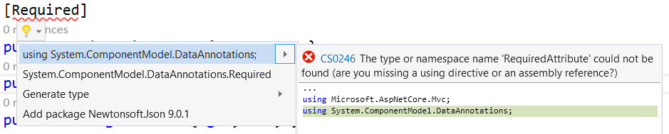
Adding Annotations - simplest method to add the annotation's "using" clause
Add an annotation you can spell that doesn't need parameters
[Required]
public string Title { get; set; }
Right-click … open lightbulb for ideas:
Select: using System.ComponentModel.DataAnnotations;
…or type it yourself.

Slide 11
[Display(Name = "Artist")] public string ArtistId { get; set; }
Database field-names aren't always clear
A drop-down will provide the ArtistId for this album
But the user sees artist names, never the ID
…so display "Artist" or "Artist Name" in the field heading & errors
What they're seeing, not how it's used

Slide 12
[Display(Name = "ArtistId", ResourceType =typeof(Resources.Translations))] public string ArtistId { get; set; }
Format used to translate field-names in the model
Uses resource files namedTranslations like:
Translations.resx Translations.de.resx
Translations.fr.resx Translations.zh-CN.resx
Each file is for a different language … default (I use English), German, French, and Chinese (mainland China)
These contain key/value pairs
The "key" indexing into these files is the "Name=" field
Must be a valid C# variable name: → can't be "Artist Name"
…and it won't default to the property name … it must be a Name= attribute
The "value" is the required term, translated

Slide 13
[DisplayFormat(ApplyFormatInEditMode = false, DataFormatString = "{0:c}")] public float Price { get; set; }
Applies standard formatting to a field
Does not affect the field's value, just how it's displayed
DataFormatString="{0:c}"
→ defaults to false … add in if you do want formatting … see later
ApplyFormatInEditMode=false
Formatted numeric data ($12.50) may not fit a field's datatype
This skips formatting when the field is in edit mode
Dates (23 Jun 2016, Jun 23 2016 and 23/06/2016) are OK with formatting
ConvertEmptyStringToNull=true
Hidden input fields with no value attribute return ""
Receiving datatypes like Int32? and float? will abend on "", but not on null

Slide 14
[DisplayFormat] attributes cont'd good intentions … let me know if these work in ASP.NET Core or if you can get them to work …
HtmlEncode=true
Intent: encode HTML in input before Binder places it into the model
Allowing HTML tags & script from user, but storing as non-functional &lt; stuff
However, page errors-out on invalid input before it gets here
NullDisplayText=“no album title"
Text displayed if data inserted from model is null
Pretty useless, actually
Not a placeholder prompt … so just add this attribute to the element:
placeholder="enter album title"

Slide 15
[DisplayFormat] attribute: DataFormatString="{0:c}"
0 (index zero)
Means this applies to 1st parameter (the only one)
C
Format as currency: $ symbol, commas, 2 decimal places
Same format string you would use in code:
Price.ToString("c")
DateOfBirth.ToString("dddd, dd MMM yyyy")

Slide 16
Formatting Numbers Banker's rounding: midpoints (10.535 & 10.545) round towards the even number (10.54)
Format Specifier | Description | Effect
C or c | Currency: bracket negative, commas, 2 decimals default, rounded, system currency symbol | Double growthRate = 2085.03 growthRate.ToString("c") → $2,085.03
D or d | Decimal (integers): integer, zero-padded to number of digits specified | Int32 classCount = 30 classCount.ToString("d3") → 030
D or d | for Date variables: see next page
F or f | Fixed-point: real number, decimal part rounded/padded to given # digits, no commas | Double growthRate = 0.3 growthRate.ToString("f3") → 0.300
N or n | Number: leading minus, commas, 2 decimals default, rounded/padded to given # digits | Double growthRate = 2085.06 growthRate.ToString("n1") → 2,085.1
P or p | Percent: number converted to percentage, with "%" | Couble growthRate = 0.3 growthRate.ToString("p3") → 30.000%

Slide 17
Formatting Dates
D, d January 21, 2007 21/01/2007
Date: long ("D") short ("d")
T, t 3:05:46 PM 3:05 PM
Time: long short
F, f January 21, 2007 3:05:46 PM
Full date-time: long (shown) & short (no seconds)
U January 21, 2007 8:05:46 PM
Long date-time, converted to Universal time (aka zulu or GMT)

Slide 18
Converting Dates: custom formats sample: Monday 8 January, 2007, 1:07:05 PM
h, hh, H, HH
Hour: 1, 01, 13, 13
m, mm
Minute: 7, 07
s, ss
Second: 5, 05
t, tt
P, PM
d, dd, ddd, dddd
Day: 8, 08, Mon, Monday
M, MM, MMM, MMMM
Month: 1, 01, Jan, January
y, yy, yyyy
Year: 7, 07, 2007
All other characters
Straight-piped to output
[DisplayFormat(DataFormatString="{0: dddd d MMMM, yyyy, h:mm:ss tt}")];
public DateTime DateOfBirth { get; set; }

Slide 19
[ReadOnly(true)] public String AlbumArtUrl { get; set; }
At post-back: tells model binder:
"Do not set this property with a new value"
But: it still shows as an enabled input textbox
Users will pick at it & freak out if they forget what it was
Binder continues to respect ReadOnly
Try: [HiddenInput(DisplayValue=true)]
This displays the value as text on the page
And hides the field-name with its original value as an input field
… um … Core 1.0.1 … won’t display the value.

Slide 20
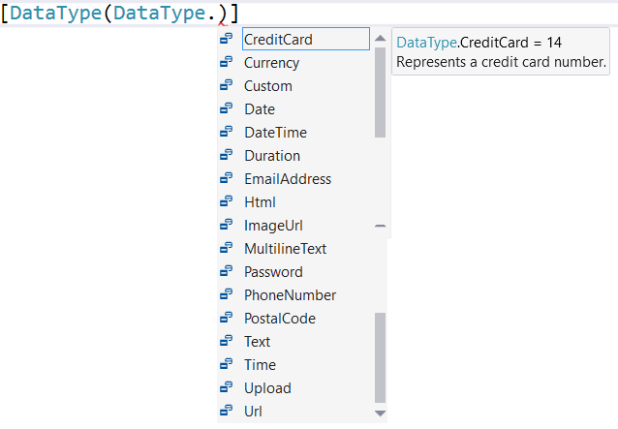
[DataType(DataType.Url)] public DateTime AlbumArtUrl { get; set; }
Information about the purpose of a property
Strings can mean many things
May create specific HTML elements, like:
DataType.Password
DataType.EmailAddress
This'll add HTML5 validation on the page
Most haven't been implemented

Slide 21
[HiddenInput(DisplayValue=false)] public String AlbumId { get; set; }
Renders an input element of type hidden
Containing the original value
Manually-coded hidden elements commonly forget the value= attribute
Browser will send field value back to server
But it's hidden from the user … and so is the field's label
Still visible in view source
Can be altered by nasties on submission
DisplayValue=true
Will also display the field's value, but as a label … users can't pick at it
… not implemented in .Net Core 1.01 …

